Slide 1
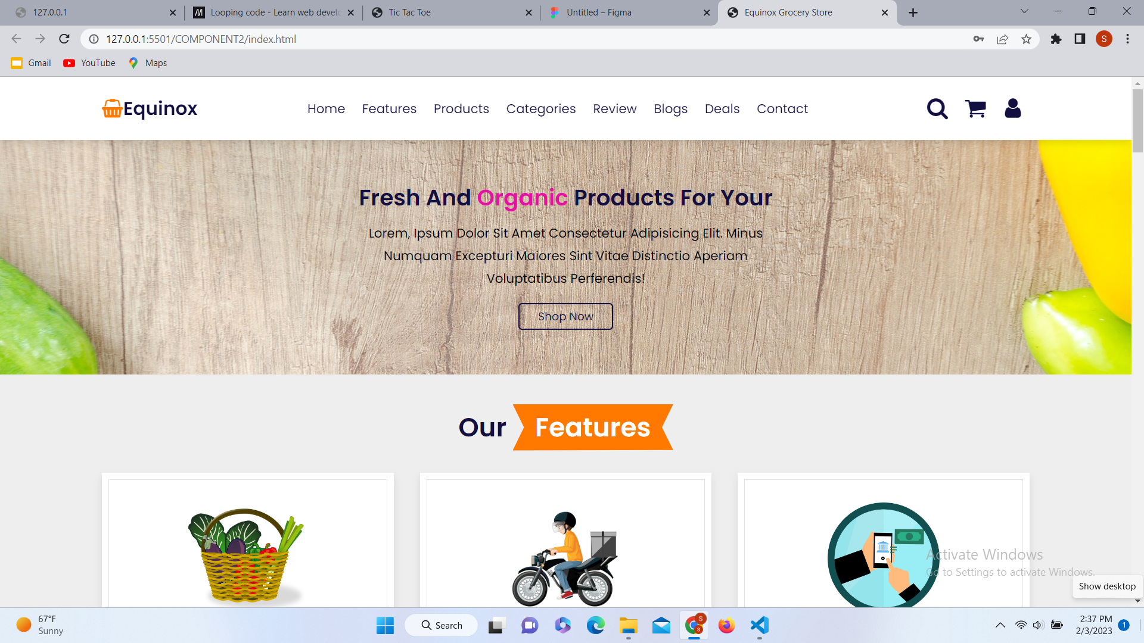
E-commerce Grocery Website

Slide 2
Objective of E-commerce Grocery Website
To offer a wide range of grocery products to customers online.
To provide an easy and convenient shopping experience.
To provide accurate and detailed product information to customers.
To ensure timely and efficient delivery of orders.
To build trust with customers through secure payment options and a clear privacy policy.
To remain competitive in pricing and offer regular promotions.
To continuously gather customer feedback and make improvements to enhance the overall shopping experience.
To increase sales and customer satisfaction for the business.

Slide 3
Introduction
An e-commerce grocery store website is an online platform that allows customers to purchase grocery products through the internet. It offers a convenient and accessible shopping experience, providing customers with a wide selection of food, household and personal care items, as well as other grocery essentials. Customers can browse and purchase items, and have their orders delivered directly to their doorstep. With the increasing popularity of online shopping, e-commerce grocery store websites have become an important part of the retail landscape, offering customers the ability to shop for groceries from the comfort of their own homes. The objective of these websites is to provide customers with a convenient and seamless shopping experience, while also increasing sales and customer satisfaction for the business.

Slide 4
Technology Used
I have used following technology to make this website.
For frontend development I have use tools such as HTML, CSS and JavaScript to design and develop the website’s user Interface. The website is optimized for viewing on mobile devices to ensure a consistent shopping experience for customers regardless of device.

Slide 5
Future enhancement
Back-end Development Tools can be used such as PHP which is used to develop the server-side functionality of the website.
Content Management System (CMS) can be used such as WordPress which is used to manage and organize the website's content and products.
E-commerce Platform such as Shopify or WooCommerce can be used to handle the transaction and payment process.
A database such as MySQL can be used to store customer information, product information, and orders.
A payment gateway such as Stripe can be used to integrate into the website to securely process payments.

Slide 6
Conclusion
In conclusion, e-commerce grocery websites have revolutionized the way customers shop for groceries. By providing a convenient and accessible platform for shopping, these websites have made it easier for customers to purchase the products they need without leaving their homes. The technology used to develop these websites is constantly evolving, with new innovations and enhancements being introduced to provide customers with an even better shopping experience. With the growing popularity of online shopping, e-commerce grocery websites will continue to play an important role in the retail landscape, and the future of these websites looks bright with exciting possibilities for growth and expansion. Ultimately, the goal of these websites is to provide customers with a seamless and enjoyable shopping experience while driving sales and increasing customer satisfaction for the business.

